Slide 1

Provide insights to Chief of Operations in Transportation Domain
CODEBASICS RESUME PROJECT CHALLLENGE #13
Presented By Abhinai Kaspa

Slide 2


Slide 3
About Goodcabs
Primary Analysis
Problem Statement
Agenda
Further Analysis
Objectives
Insights
Business Requests
Recommendations

Slide 4

About Goodcabs
GOODCABS is a cab service company established 2 years ago in Indian market in 2-Tier cities
Unlike other cab companies goodcabs support local drivers helping them to make sustainable living in their hometowns while ensuring excellent service to passengers
They are operating Ten 2 – Tier cities across India

Slide 5
Problem Statement
Goodcabs has set an ambitious performance targets for 2024
The goal is to drive their company growth and improve their passengers satisfaction
As part of this initiative goodcabs management team wants to understand company performance against some key metrics like
1. Trip Volume
2. Passenger Satisfaction
3. Repeat Passenger Rate
4. Trip Distribution
5. Balance between new and repeat passengers

Slide 6
Objectives
Data exploration by analysing datasets and metadata
Designing a Metrics Dashboard
Addressing Business Requests
Addressing Primary and further questions
Insights
Recommendations to Goodcabs

Slide 7
Data Exploration
Dimension Tables
Dim_city
Dim_date
Dim_repeat_trip_distribution
Fact Tables
Fact passenger summary
Fact trips
Targets Tables
City Target Passengers Rating
Monthly target new passengers
Monthly target trips

Slide 8
Business Requests

Slide 9
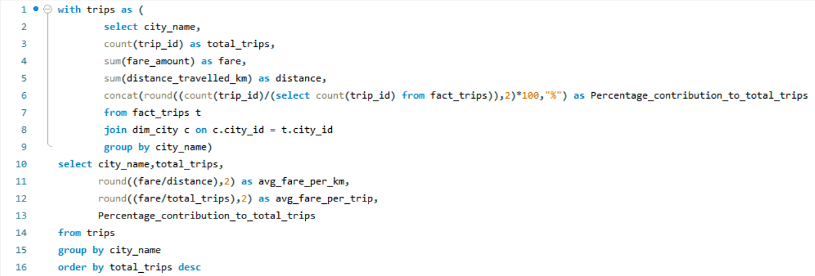
Business Request - 1:
City-Level Fare and Trip Summary Report
Generate a report that displays the total trips, average fare per km, average fare per trip, and the percentage contribution of each city’s trips to the overall trips. This report will help in assessing trip volume, pricing efficiency, and each city’s contribution to the overall trip count. Fields:city_name,total_trips,avg_fare_per_km,avg_fare_per trip,%_contribution_to_total_trips
Query:

Slide 10
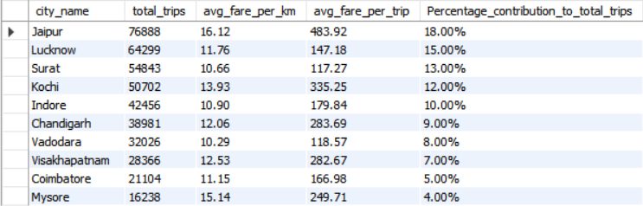
Business Request - 1:
City-Level Fare and Trip Summary Report
Generate a report that displays the total trips, average fare per km, average fare per trip, and the percentage contribution of each city’s trips to the overall trips. This report will help in assessing trip volume, pricing efficiency, and each city’s contribution to the overall trip count. Fields:city_name,total_trips,avg_fare_per_km,avg_fare_per trip,%_contribution_to_total_trips
Output:

Slide 11
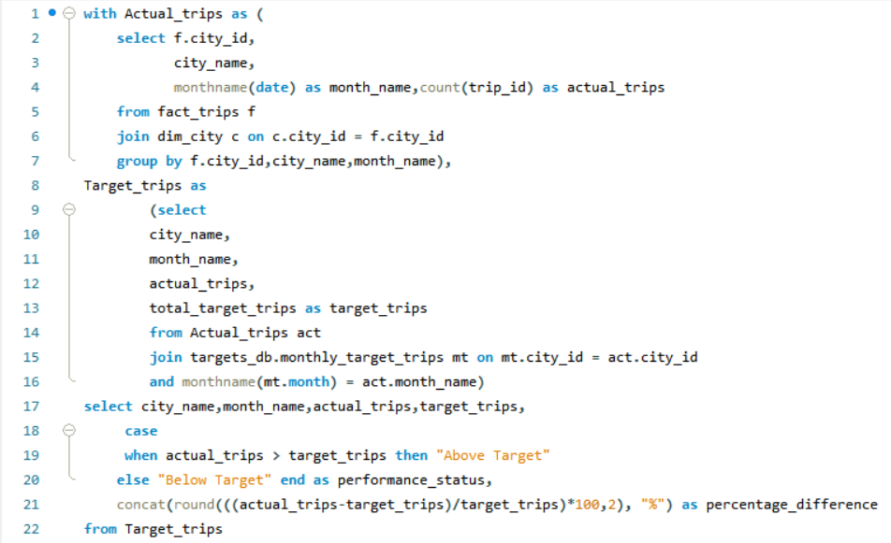
Business Request - 2:
Monthly City-Level Trips Target Performance Report
Generate a report that evaluates the target performance for trips at the monthly and city level. For each city and month, compare the actual total trips with the target trips and categorise the performance as follows: lf actual trips are greater than target trips, mark it as "Above Target". lf actual trips are less than or equal to target trips, mark it as "Below Target". Additionally, calculate the % difference between actual and target trips to quantify the performance gap.Fields:City_namemonth_nameactual_tripstarget_tripsperformance_status%_difference
Query:

Slide 12
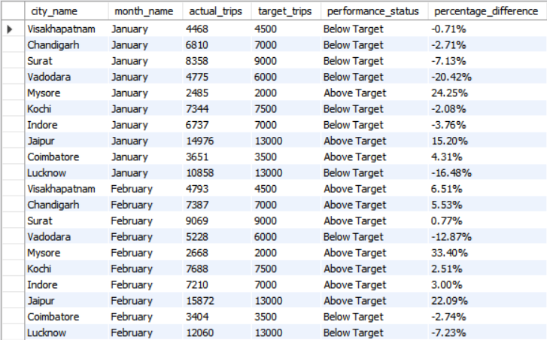
Business Request - 2:
Monthly City-Level Trips Target Performance Report
Generate a report that evaluates the target performance for trips at the monthly and city level. For each city and month, compare the actual total trips with the target trips and categorise the performance as follows: lf actual trips are greater than target trips, mark it as "Above Target". lf actual trips are less than or equal to target trips, mark it as "Below Target". Additionally, calculate the % difference between actual and target trips to quantify the performance gap.Fields:City_namemonth_nameactual_tripstarget_tripsperformance_status%_difference
Output:

Slide 13
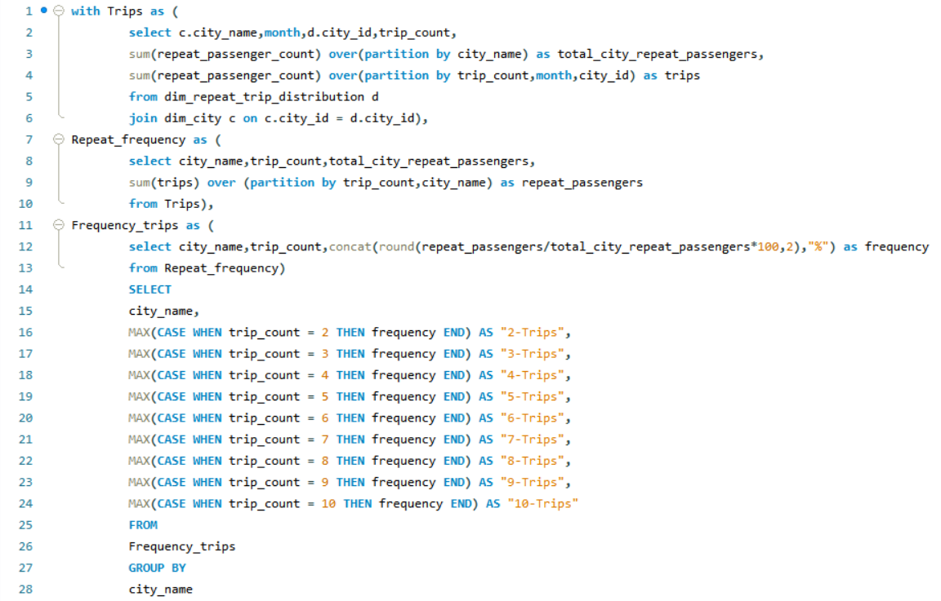
Business Request - 3:
City-Level Repeat Passenger Trip Frequency Report
Generate a report that shows the percentage distribution of repeat passengers by the number of trips they have taken in each city. Calculate the percentage of repeat passengers who took 2 trips, 3 trips, and so on, up to 10 trips. Each column should represent a trip count category, displaying the percentage of repeat passengers who fall into that category out of the total repeat passengers for that city. Fields: city_name, 2-Trips, 3-Trips, 4-Trips, 5-Trips, 6-Trips, 7-Trips, 8-Trips, 9-Trips,10-Trips
Query:

Slide 14
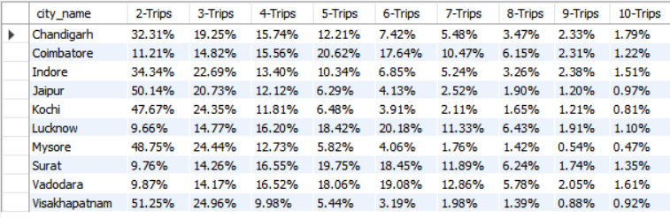
Business Request - 3:
City-Level Repeat Passenger Trip Frequency Report
Generate a report that shows the percentage distribution of repeat passengers by the number of trips they have taken in each city. Calculate the percentage of repeat passengers who took 2 trips, 3 trips, and so on, up to 10 trips. Each column should represent a trip count category, displaying the percentage of repeat passengers who fall into that category out of the total repeat passengers for that city. Fields: city_name, 2-Trips, 3-Trips, 4-Trips, 5-Trips, 6-Trips, 7-Trips, 8-Trips, 9-Trips,10-Trips
Output:

Slide 15
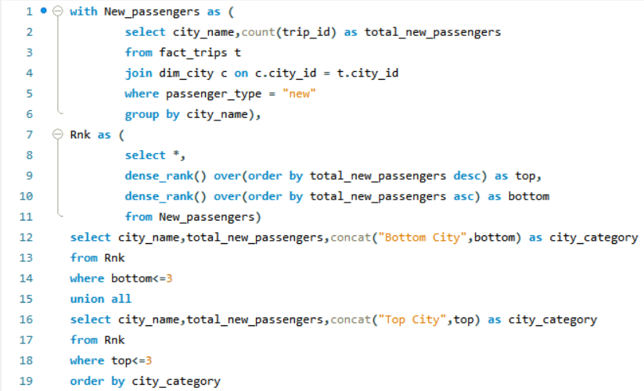
Business Request - 4: Identify Cities with Highest and Lowest Total New Passengers
Generate a report that calculates the total new passengers for each city and ranks them based on this value. Identify the top 3 cities with the highest number of new passengers as well as the bottom 3 cities with the lowest number of new passengers, categorizing them as "Top 3" or "Bottom 3" accordingly. Fields: city_namee total_new_passengerse city_category ("Top 3" or "Bottom 3")
Query:

Slide 16
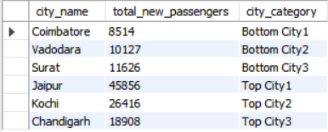
Business Request - 4: Identify Cities with Highest and Lowest Total New Passengers
Generate a report that calculates the total new passengers for each city and ranks them based on this value. Identify the top 3 cities with the highest number of new passengers as well as the bottom 3 cities with the lowest number of new passengers, categorizing them as "Top 3" or "Bottom 3" accordingly. Fields: city_namee total_new_passengerse city_category ("Top 3" or "Bottom 3")
Output:

Slide 17
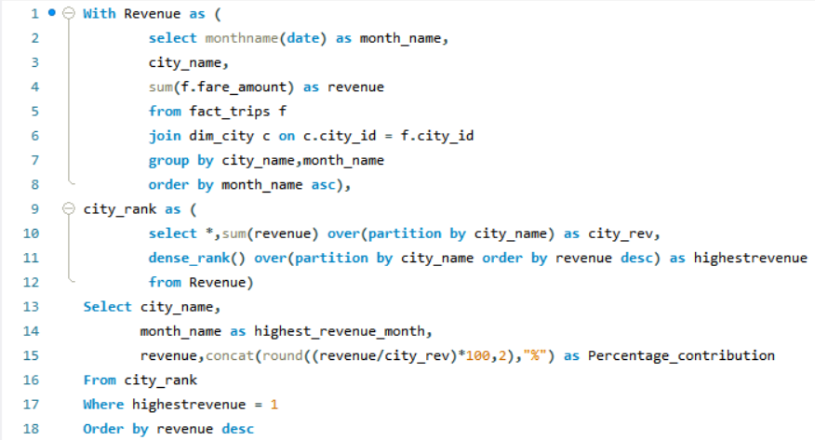
Business Request - 5: Identify Month with Highest Revenue for Each City
Generate a report that identifies the month with the highest revenue for each city. For each city, display the month_name, the revenue amount for that month, and the percentage contribution of that month’s revenue to the city’s total revenue.Fieldscity_namehighest_revenue_monthrevenuepercentage_contribution (%)
Query:

Slide 18
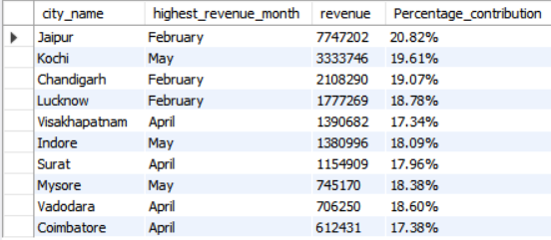
Business Request - 5: Identify Month with Highest Revenue for Each City
Generate a report that identifies the month with the highest revenue for each city. For each city, display the month_name, the revenue amount for that month, and the percentage contribution of that month’s revenue to the city’s total revenue.Fieldscity_namehighest_revenue_monthrevenuepercentage_contribution (%)
Output:

Slide 19
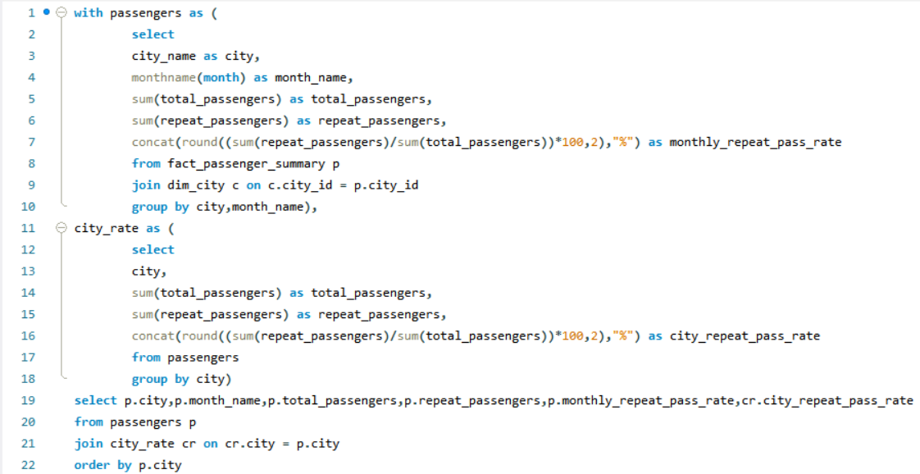
Business Request - 6: Repeat Passenger Rate Analysis
Generate a report that calculates two metrics:1. Monthly Repeat Passenger Rate: Calculate the repeat passenger rate for each city and month by comparing the number of repeat passengers to the total passengers.2. City-wide Repeat Passenger Rate: Calculate the overall repeat passenger rate foreach city, considering all passengers across months. Fields:city_name,month,total_passengers,repeat_passengers
monthly_repeat_passenger_rate (%): Repeat passenger rate at the city and month level
city_repeat_passenger_rate (%): Overall repeat passenger rate for each city, aggregated across months
Query:

Slide 20
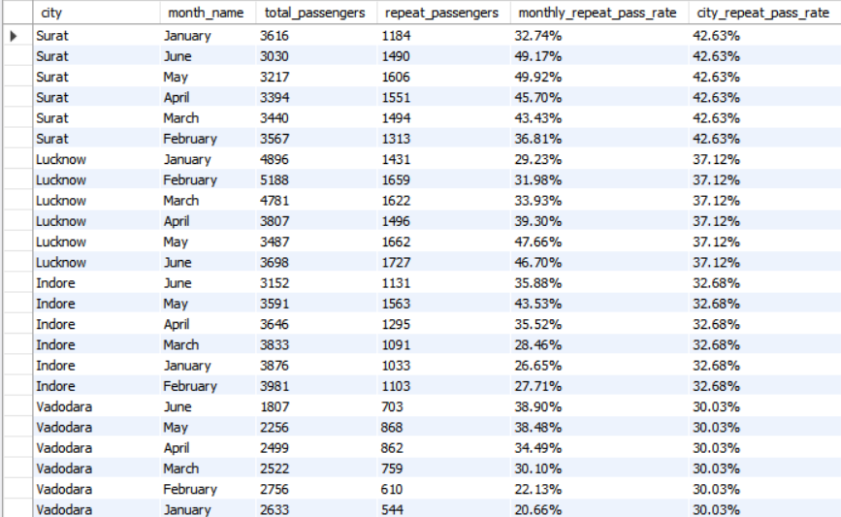
Business Request - 6: Repeat Passenger Rate Analysis
Generate a report that calculates two metrics:1. Monthly Repeat Passenger Rate: Calculate the repeat passenger rate for each city and month by comparing the number of repeat passengers to the total passengers.2. City-wide Repeat Passenger Rate: Calculate the overall repeat passenger rate foreach city, considering all passengers across months. Fields:city_name,month,total_passengers,repeat_passengers
monthly_repeat_passenger_rate (%): Repeat passenger rate at the city and month level
city_repeat_passenger_rate (%): Overall repeat passenger rate for each city, aggregated across months
Output:

Slide 21
Primary Analysis

Slide 22
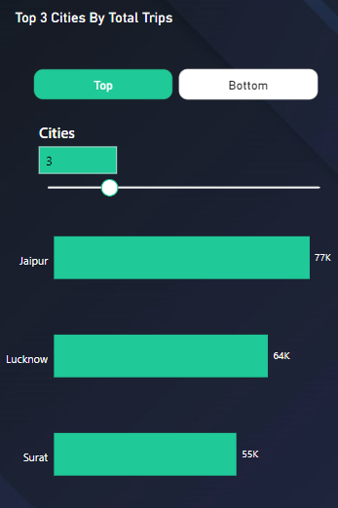
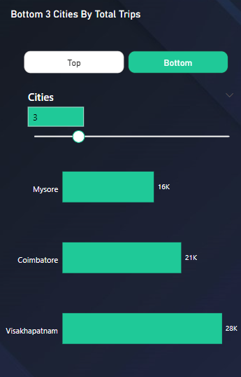
Top and Bottom Performing Cities Identify the top 3 and bottom 3 cities by total trips over the entire analysis period.
Top 3 cities by total trips are
Jaipur – 77K
Lucknow – 64K
Surat – 55K
Bottom 3 cities by total trips are
Mysore – 16K
Coimbatore – 21K
Visakhapatnam – 28K

Slide 23
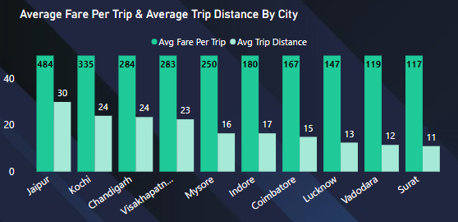
2. Average Fare per Trip by City
Calculate the average fare per trip for each city and compare it with the city’s average trip distance. Identify the cities with the highest and lowest average fare per trip to assess pricing efficiency across locations.
Average Fare Per Trip = Total Fare/Total no of Trips
Average Trip Distance = Total Distance/total Trips
Jaipur has the highest average fare per trip with Rs 484 with average trip distance of 30 km
Surat has the lowest average fare per trip with Rs 117 with average trip distance of 11 km

Slide 24
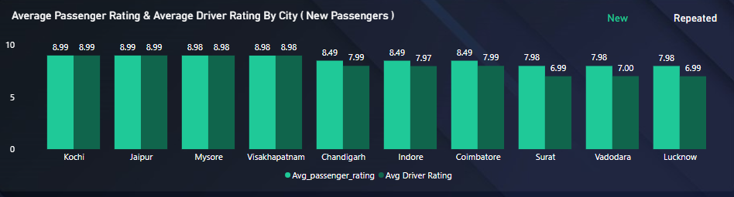
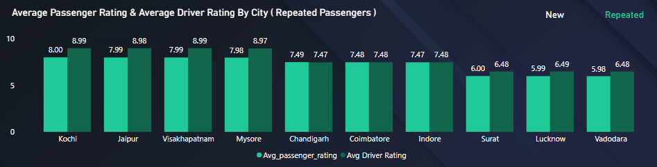
3. Average Ratings by City and Passenger Type
Calculate the average passenger and driver ratings for each city, segmented by passenger type (new vs. Repeat).
Average passenger rating ranges between 8-9 for new passengers
Average Driver Rating ranges between 7-9 for new passengers
Average passenger rating ranges between 6-8 for Repeat passengers
Average Driver Rating ranges between 6.5-9 for repeat passengers

Slide 25
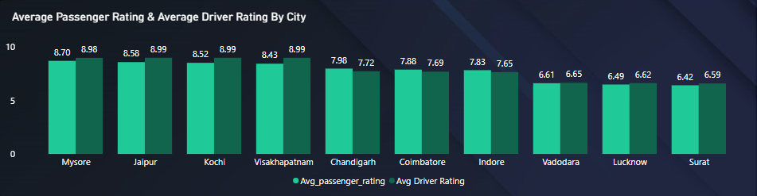
Identify cities with the highest and lowest average ratings.
Highest average rating cities are Mysore , Jaipur , Kochi , Visakhapatnam
Lowest average rating cities are Surat, Lucknow , Vadodara

Slide 26
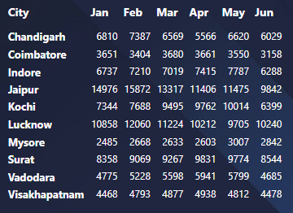
4. Peak and Low Demand Months by City
For each city, identify the month with the highest total trips (peak demand)
and the month with the lowest total trips (low demand).
City | Peak Demand | Low Demand
Chandigarh | February | April
Coimbatore | March | June
Indore | May | June
Jaipur | February | June
Kochi | May | June
Lucknow | February | May
Mysore | May | January
Surat | April | January
Vadodara | April | June
Visakhapatnam | April | January
Low Demand
Peak Demand
Overall Peak demand months for total trips are February , April , May
Overall Low demand months for total trips are January , April , June

Slide 27
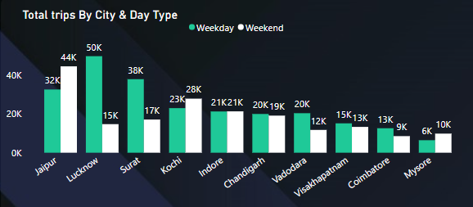
5. Weekend vs. Weekday Trip Demand by City
Compare the total trips taken on weekdays versus weekends for each city over the six-month period. Identify cities with a strong preference for either weekend or weekday trips to understand demand variations.
Cities like Jaipur, Kochi, Mysore have strong preference for weekend trips
Cities like Lucknow , Surat , Vadodara, Visakhapatnam, Coimbatore have stronger preference in weekday trips

Slide 28
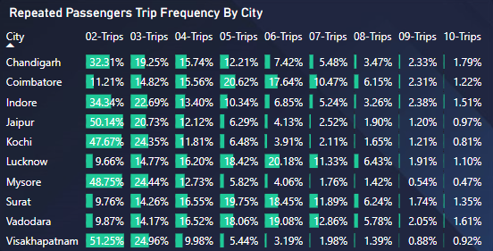
6. Repeat Passenger Frequency and City Contribution Analysis
Analyse the frequency of trips taken by repeat passengers in each city(e.g., % of repeat passengers taking 2 trips, 3 trips, etc.). Identify which cities contribute most to higher trip frequencies among repeat passengers, and examine if there are distinguishable patterns between tourism-focused and business-focused cities.

Slide 29
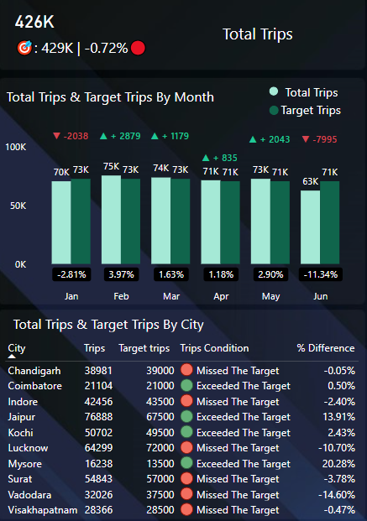
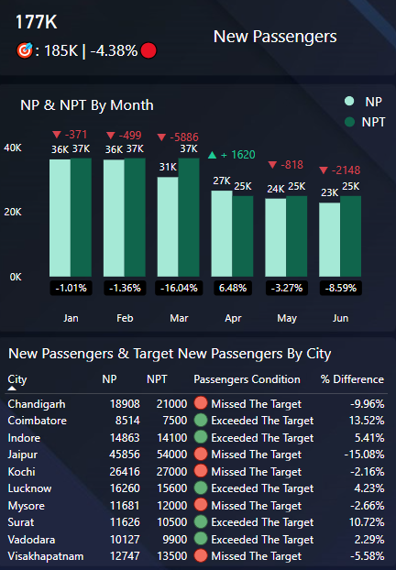
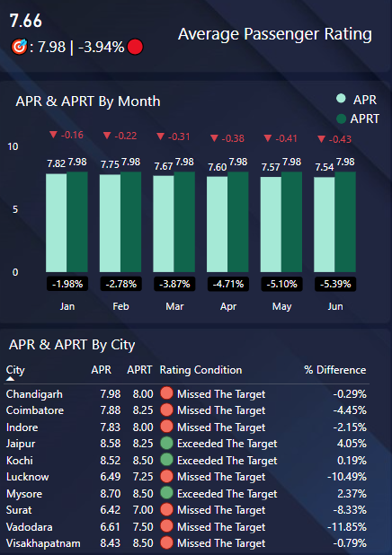
7. Monthly Target Achievement Analysis for Key Metrics
For each city, evaluate monthly performance against targets for Total trips, New Passengers, and Average Passenger Ratings from targets_db. Determine if each metric met, exceeded, or missed the target, and calculate the percentage difference. Identify any consistent patterns in target achievement, particularly across tourism versus business-focused cities.
NP – New Passengers | NPT – New Passengers Target | APR – Average Passenger Rating | APRT – Average Passenger Rating Target

Slide 30
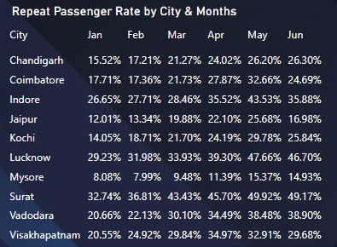
8. Highest and Lowest Repeat Passenger Rate (RPR%) by City and Month
Analyse the Repeat Passenger Rate (RPR%) for each city across the six-month period. Similarly, analyse the RPR% by month across all cities and identify the months with the highest and lowest repeat passenger rates. This will help top in point any seasonal patterns or months with higher repeat passenger loyalty.
City | High Repeat Passenger Rate Month | Low Repeat Passenger Rate Month
Chandigarh | June | January
Coimbatore | May | February
Indore | May | January
Jaipur | May | January
Kochi | May | January
Lucknow | May | January
Mysore | May | February
Surat | May | January
Vadodara | June | January
Visakhapatnam | April | January
Lowest RPR%
Highest RPR%
Highest Repeat Passenger Rate Months are April, May , June
Lowest Repeat Passenger Rate Months are January , February

Slide 31
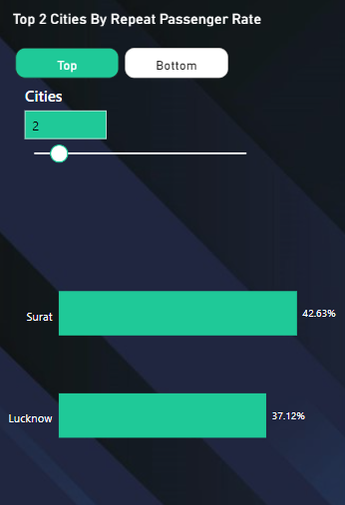
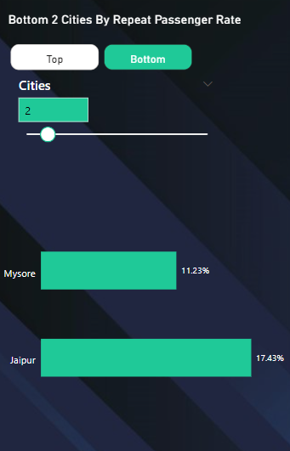
8.Identify the top 2 and bottom 2 cities based on their RPR% to determine which locations have the strongest and weakest rates.
Top 2 Cities based on Repeat Passenger Rate are
Surat – 42.63%
Lucknow – 37.12%
Bottom 2 Cities based on Repeat Passenger Rate are
Mysore – 11.23%
Jaipur – 17.43%

Slide 32
Further Analysis

Slide 33
1. Factors Influencing Repeat Passenger Rates
What factors (such as quality of service, competitive pricing, or city demographics) might contribute to higher or lower repeat passenger rates in different cities? Are there correlations with socioeconomic or lifestyle patterns in these cities?
Quality of service
Reliability and consistency
Passengers are more likely to return if the services are punctual, efficient
Poor services like frequent delays and repeat cancellations can deter repeat passenger rate
Customer Experience
Friendliness, cleanliness, comfort significantly enhance loyalty
High customer interactions create positive associations increase repeat passengers
Safety and security
Passengers prioritize safety especially in public transport or ride sharing services
Competitive Pricing
Affordability
Competitive and transparent prices models attract conscious passengers, especially in cities with lower average income
Discounts and loyalty programs offering like discounts for frequent users, cashback or point based rewards can encourage repeat usage
City Demographics
Population Density
People rely more on public transport due to traffic congestion or limited parking
Income levels
Cities with higher income passengers may opt premium services while lower income populations may prefer affordable transportation options
Correlation with Socioeconomic and lifestyle patterns
Wealthier cities or areas might see higher adoption rates of premium services or subscription based services
Cities with strong public transport infrastructure often show a strong correlation between affordability convenience and higher repeat passenger rates
Areas with younger tech savvy guys tend to Favor ride-sharing or app-based mobility patterns increasing their repeat usage

Slide 34
2. Tourism vs. Business Demand Impact
How do tourism seasons or local events (festivals, conferences) impact Goodcabs' demand patterns? Would tailoring marketing efforts to these events increase trip volume in tourism-oriented cities?
Peak Tourism Seasons
Tourism oriented cities experience rise in demand during holidays summer vacations and major festivals. It rises the demand for transportation from airports, railways stations and moving to hotels and tourist attractions
Local Events
Conferences, cultural festivals attract large crowds these events increase short term demand for cabs particularly around venues, hotels and airports and railways stations and bus stands
Benefits of tailoring market Efforts
Promoting Goodcabs as go to transportation during these events can enhance brand visibility. Partnering with event organizers or hotels can increase credibility and reach
Offering discounts , event specific packages for event attendees can encourage higher usage
Adjusting Pricing and running localized ads during high demand periods ensures maximum revenue
Collaborating with event organizers , tourism boards allow goodcabs to provide transportation services gaining revenue and customers trust
Offering incentives for future rides can convert event based users to repeat customers

Slide 35
3. Emerging Mobility Trends and Goodcabs Adaptation
What emerging mobility trends (such as electric vehicle adoption, green energy use) are impacting the cab service market in tier-2 cities? Should Goodcabs consider integrating electric vehicles or eco-friendly initiatives to stay competitive?
EV - Adaption
Increase availability of affordable EV vehicles with government subsidies and incentives for EV purchase
Cost effectiveness of EV in terms of fuel savings and lower maintenance costs
Green Energy Use
Consumers are becoming more environmental conscious and prefer services with low carbon print
Companies with eco-friendly initiatives enjoy good enhanced brand loyalty and goodwill
Digital Transformation
Rapid adoption of ride hailing apps with features like real time tracking and contactless payments and ease of booking cabs
Integration of Ai and machine learning for route optimization to reduce emissions and travel time
Integrating EV initiatives
Integrating to EV gives advantages like Low operational costs and improved brand images but its challenging because initial investments are so high
Offering incentives for users choosing shared rides like discounts on pooled trips
Develop some programmes to inform customers about their carbon footprints and savings from eco friendly rides

Slide 36
4. Partnership Opportunities with Local Businesses
Are there opportunities for Goodcabs to partner with local businesses (such as hotels, malls, or event venues) to boost demand and improve customer loyalty? Could these partnerships drive more traffic, especially in tourism-heavy or high-footfall areas?
Partnering with Hotels Resorts Events and conferences
Hotels and resorts events and conferences can offer Goodcabs as their transportation partner for guests, Tourists, Foreign delegates and local travel
Provide hotels resorts with exclusive packages and discounted rates for guests and implement digital bookings at hotel lobbies
Collaboration with malls and shopping centres
High footfall areas like malls often need reliable transportation options especially during peak hours, sales events or holidays
Set up Goodcabs pickup and drop locations and partner with mall management to provide discounts for rides to and from the mall
Tourism & Local Attractions
Tourists often need transportations for guided tours, sightseeing and local attractions
Collaborate with tourist agencies to create bundled tourism packages that include rides with Goodcabs and popular tourist routes
Business & Corporate Tie-ups
Business offices often require transportation services for employees and visiting clients
Offer tailored packages for corporate offices including employee commutes client transfers and team outings

Slide 37
5. Data Collection for Enhanced Data-Driven Decisions
To make Goodcabs more data-driven and improve its performance across key metrics (such as repeat passenger rate, customer satisfaction, new passengers and trip volume), what additional data should Goodcabs collect? Consider data that could provide deeper insights into customer behaviour,operational efficiency, and market trends.
Customer Feedback
Rating and reviews for drivers, vehicles and service operational feedback
Trip frequency, preferred pickup and drop locations, payment methods
Interactions with app and response to promotions, discounts and loyalty programs
Operational Efficiency
Drivers performance, ratings and pick up time, trip acceptance rate and cancellations
Vehicle conditions, cleanliness reports and fuel efficiency
Actual vs estimated travel time, waiting times and delays
Complaints related to safety, driver conduct and service quality
Market trends
Upcoming events impacting traffic and demand
Identifying loyal customers and their behaviour and analysing churn rate
Ease of onboarding and common barriers faced by new users
Technology and App Interactions
Drop-off points in the customer journey
App crashes and loading time and technical complaints
Engagement with SMS and notifications about new discounts and offers and tourism packages

Slide 38
Insights

Slide 39
Insights
Jaipur has the highest trips of 72K and Mysore has the lowest trips of 16K. Indore, Chandigarh , Vadodara have the medium with 42K,38K,32K trips.
Passengers are satisfied with the service in the cities like Mysore, Jaipur, Kochi but in cities like Vadodara, Lucknow, Surat passengers are not satisfied with the services has received the low rating compared to other cities
For Repeated Passenger Rate(RPR) Surat & Lucknow has the highest RPR and Mysore & Jaipur has the lowest RPR
In Surat Jan & Feb has the lowest RPR but from march it got increased
In Mysore Feb has the lowest RPR compared to other months but noticed a drop in June
In Jaipur June has high drop rate of RPR from 25%-16%
Weekend trips RPR is high compared to Weekday trips only Jaipur has the high RPR in weekday trips
Visakhapatnam , Jaipur , Mysore , Kochi , Chandigarh cities have highest trip frequency of 2-trips by repeat Passengers
Jaipur has the highest new passengers of 46K and Coimbatore has the lowest new passengers of 8K
Jaipur and Lucknow has the highest number of repeat passengers of 10K and Mysore has lowest repeat passengers of 1.5K
New Passengers have steady numbers in Jan and Feb with 36K but from Mar – Jun the number gone to 23K
Repeat Passengers in Jan are 8K and it took good increase to 12K in next 4 months but experienced drop to 10K in Jun

Slide 40
Recommendations

Slide 41
Recommendations
Goodcabs to start tourist packages which include best tourist attractions in the city with a attractive price helps to attract tourists
Develop an app which gives live tracking of cab and on spot cab bookings with mobile and sharing cab live tracking to others which in case of safety and security
Share information about the tourism packages in the app
Collaborate with Malls , Restaurants and Hotels where people use the cabs mostly and offer discount prices to the customers from bookings from collaborations
Partner with events and advertise that ride to event with discount price
Adopt to EV vehicles and offer discounts for booking EV cabs which helps to reduce emissions
Gather feedback data from the passengers to understand the behaviour of the passengers and feedback about drivers
Start a initiate to add points when they review which can benefit for the cab rides in the future with the help of those points

Slide 42

Special Thanks To
Dhaval Patel Sir
Hemanand Vadivel Sir
Bruce Hariyali Sir
Codebasics
Thanks To
Sourav Saahoo
Pooja S
Bas Dohmen
Thank You

